Slide 1

1.6.15 The exponential and trigonometric functions

Slide 2
Introduction
In this topic, we will
  Deduce Euler’s formula
  Make some observations on Euler’s formula
  See a geometric interpretation
  Determine the result when e is raised to a complex power
  Verify this is likely correct
  Make some observations
    Deduce formulas for cos(z) and sin(z)

Slide 3
Review
Recall that
  Thus,

Slide 4
Taylor series
In calculus, you either have seen or will see that the exponential and trigonometric functions can be written as Taylor series:

Slide 5
Taylor series
Substitute x with jθ :
Recall that, however, j² = –1, j³ = –j, j⁴ = 1, j⁵ = j, and so on
Break this into real and imaginary components:

Slide 6
Euler’s formula
Let’s look at:
Is it not fair to say ?
  Thus, can we not write

Slide 7
Observation
Theorem:
Proof: As , it follows that
QED

Slide 8
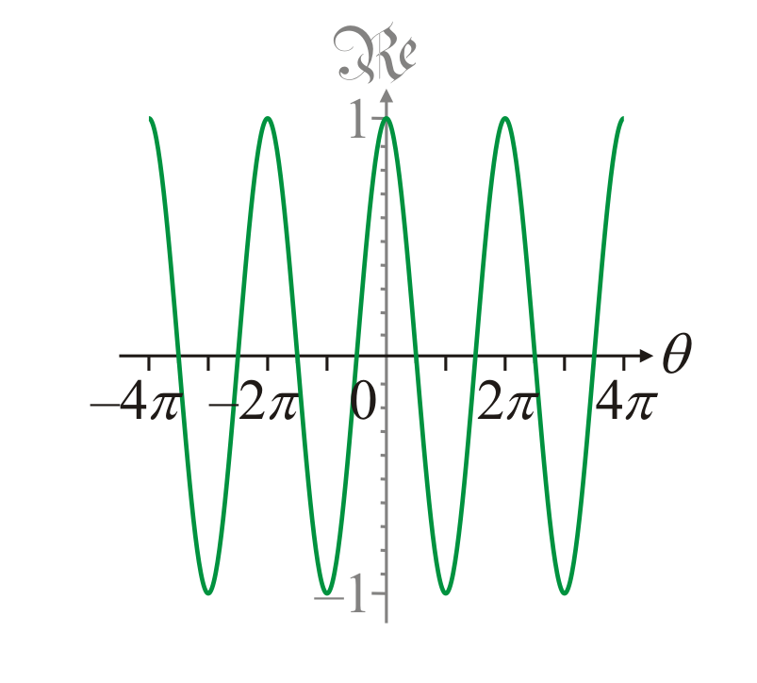
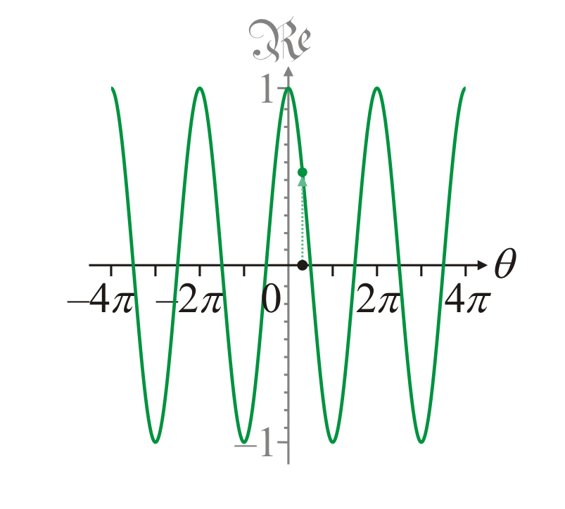
Geometric interpretation
Plotting cos(θ ) has you plot the value of cos(θ ) for all values on the abscissa
  In this case, –4π ≤ θ ≤ 4π
  You can read off the value, for example, cos(1)

Slide 9
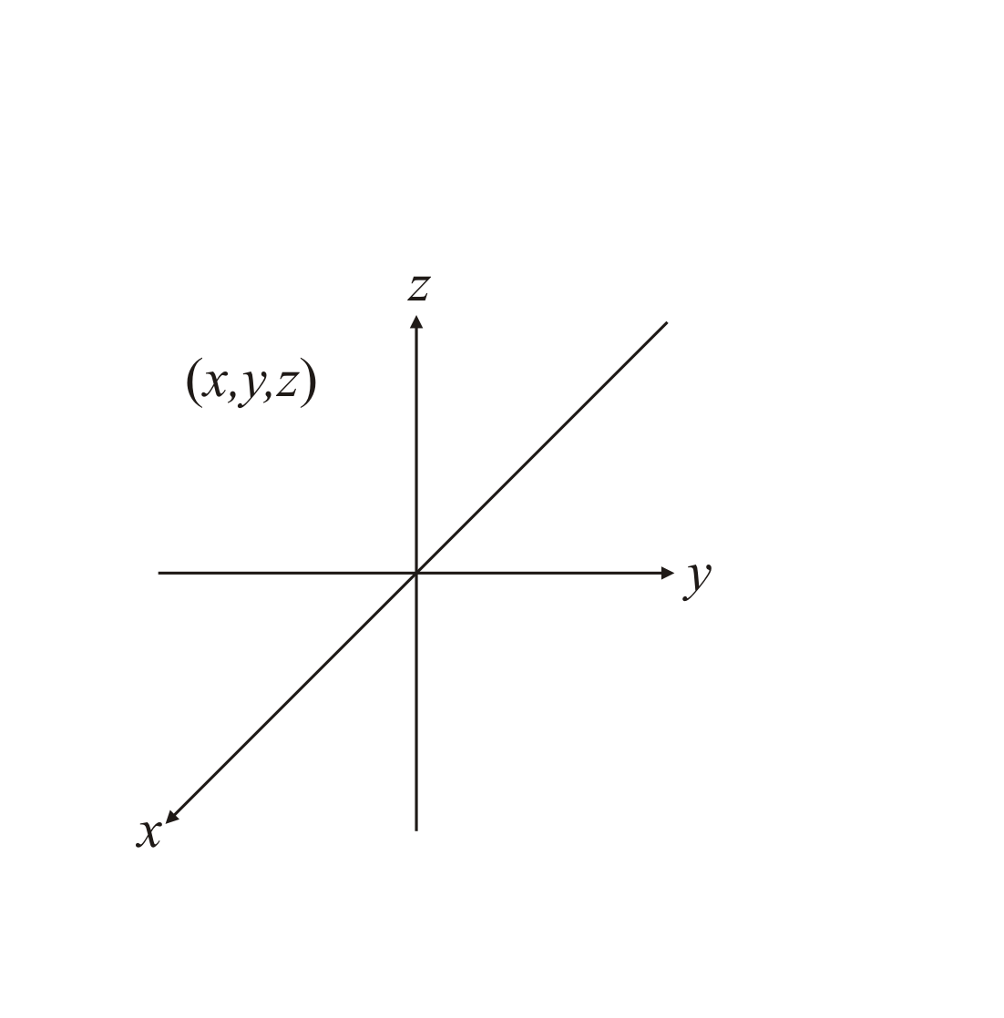
Geometric interpretation
Now, in plotting in three
dimensions, we must
project onto a plane
  We use the right-hand
  rule to determine the
  axes

Slide 10
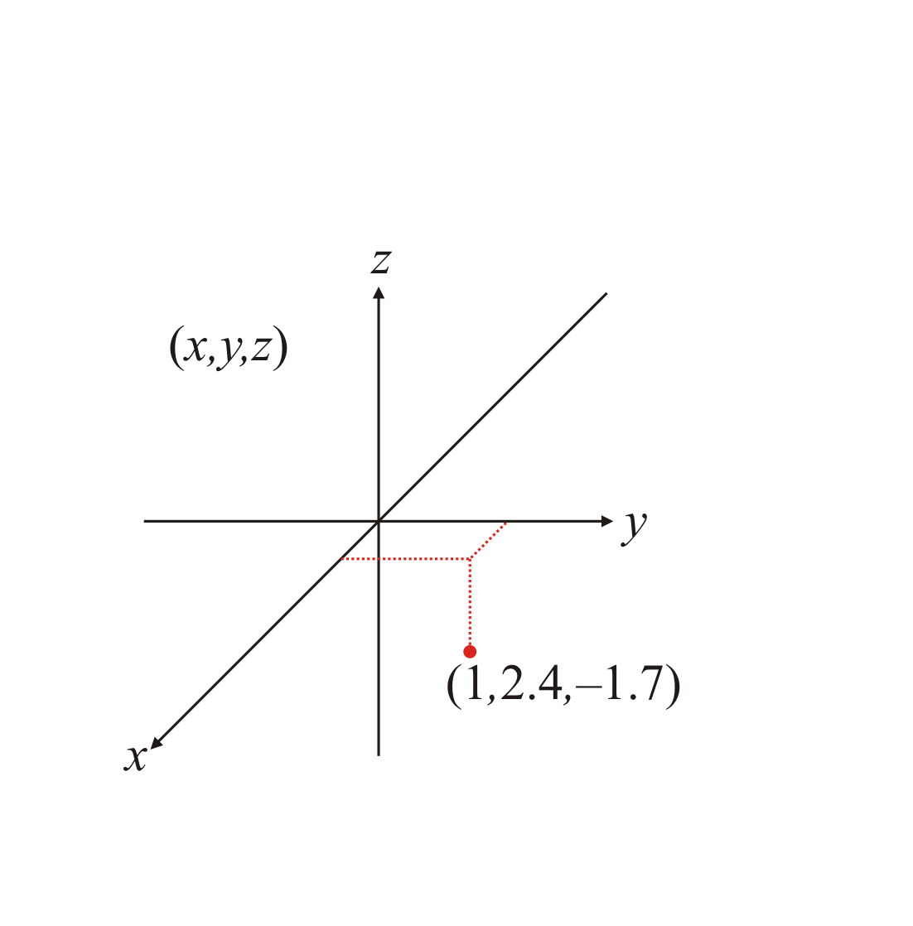
Geometric interpretation
To plot a point in three
dimensions, you need a
hint as to where that
point is relative to the
axes

Slide 11
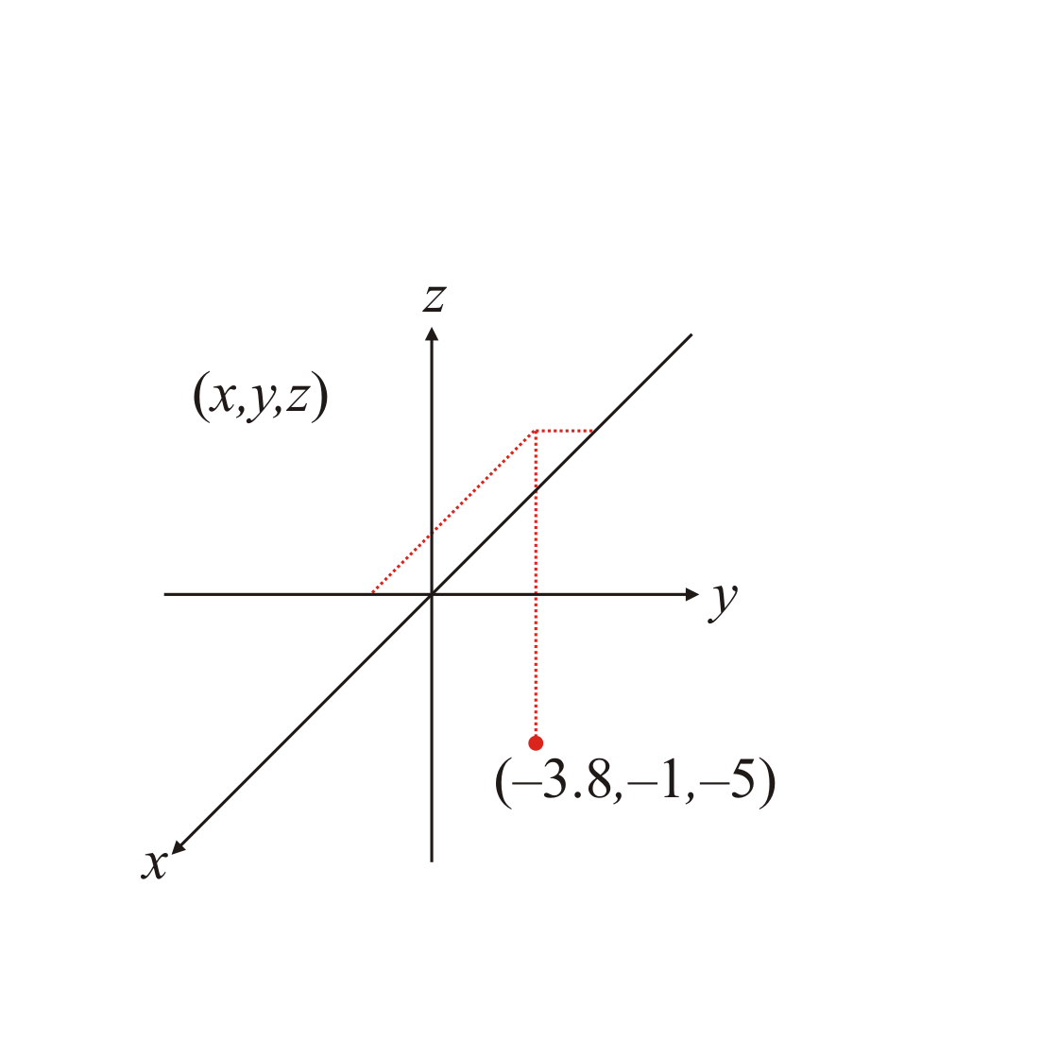
Geometric interpretation
This same point could
represent many different
values!
  This is the result of us
  projecting 3-space onto
  a plane

Slide 12
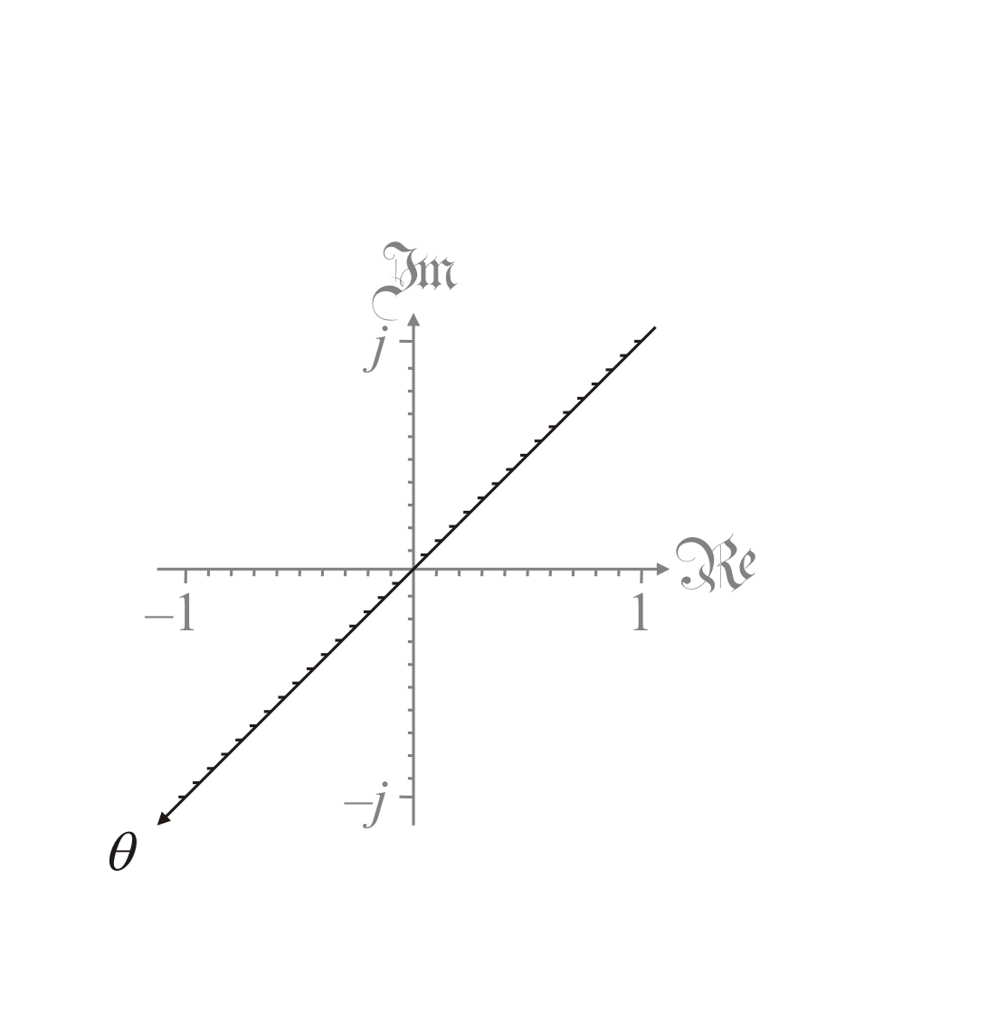
Geometric interpretation
When plotting a complex-
valued function f of a real
variable, the three axes
will represent:
  The independent
  variable θ
  The real
  component of f (θ )
  The imaginary
  component of f (θ )

Slide 13
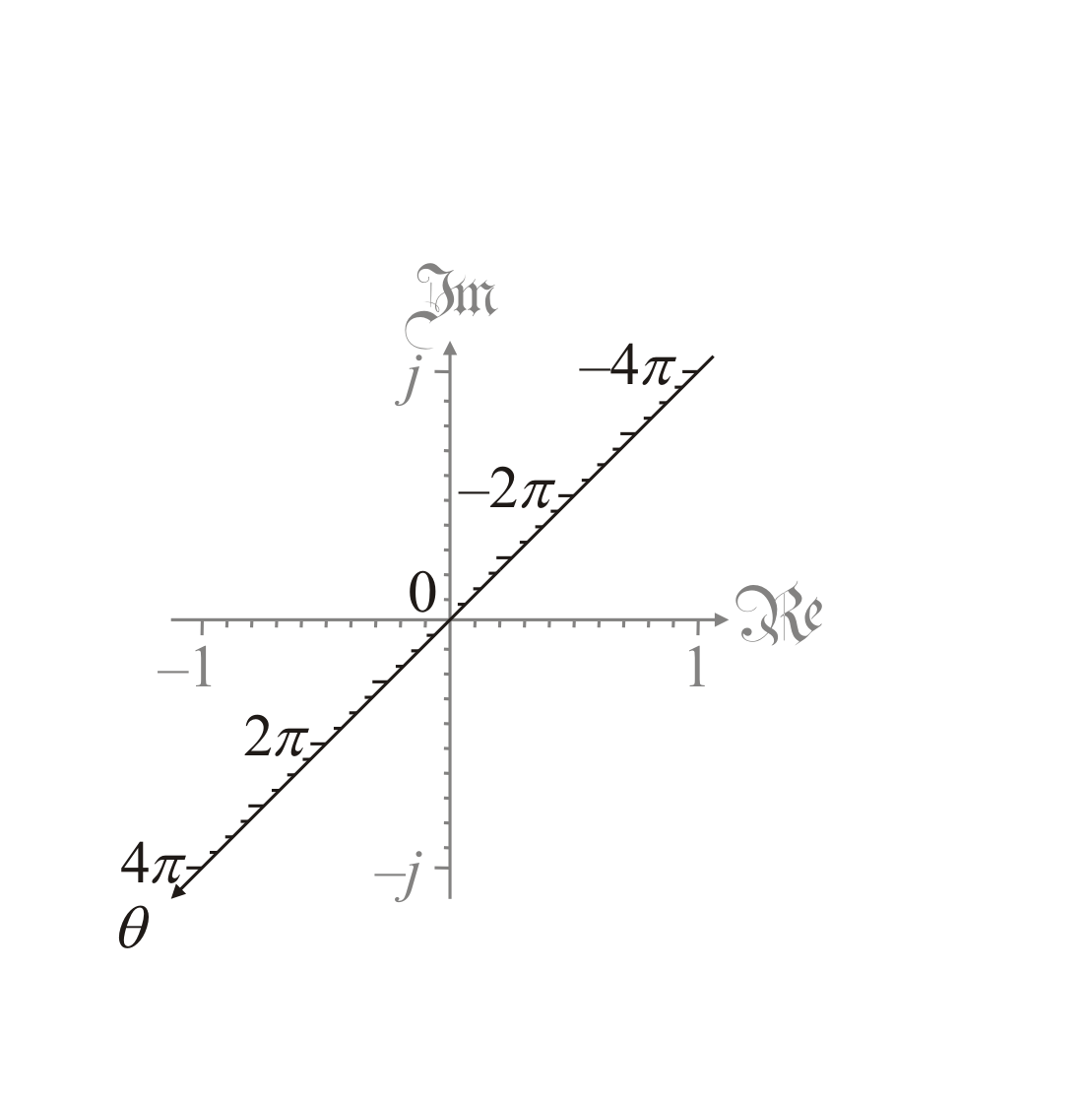
Geometric interpretation
Suppose we want to plot
a function f on
–4π ≤ θ ≤ 4π
  We will try this first
  for cos(θ ) and then
  e^{θ j}

Slide 14
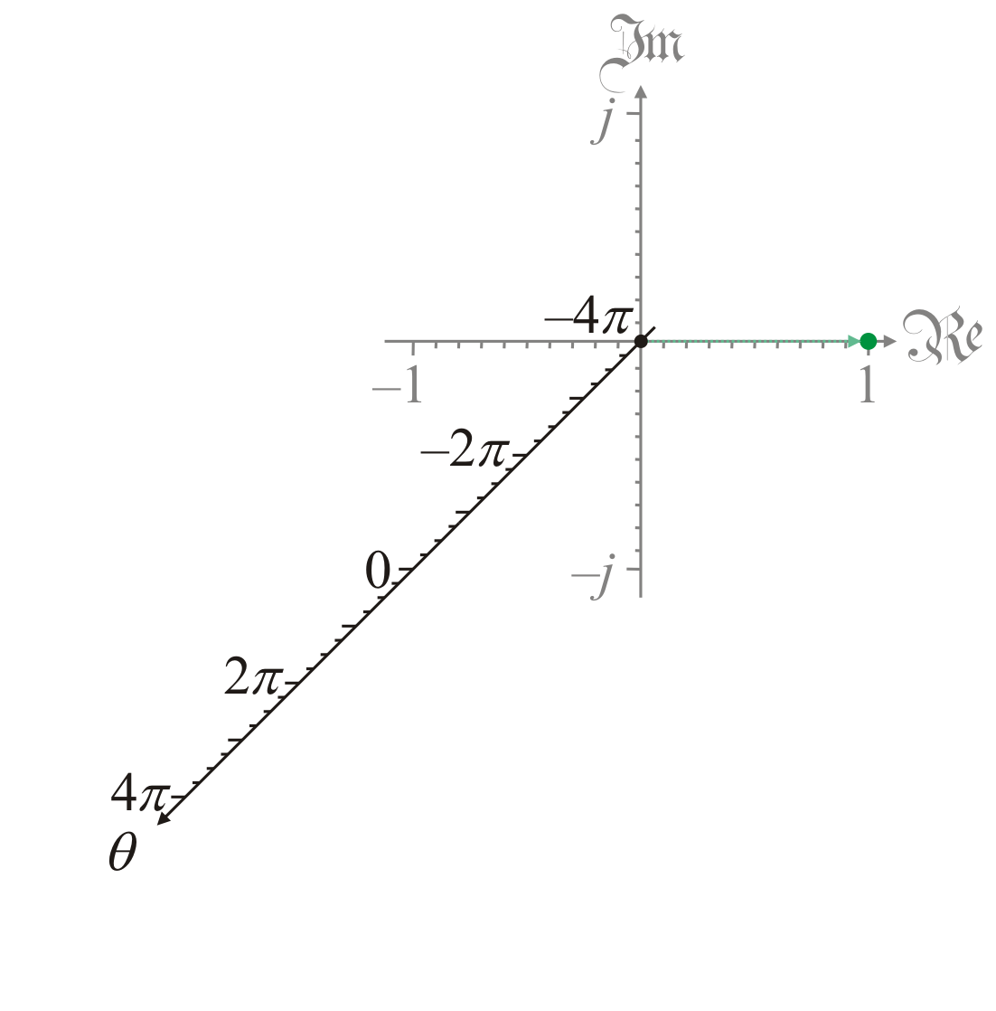
Geometric interpretation
First, we note that
a function cos(–4π ) = 1
  We emphasize this with
  an arrow

Slide 15
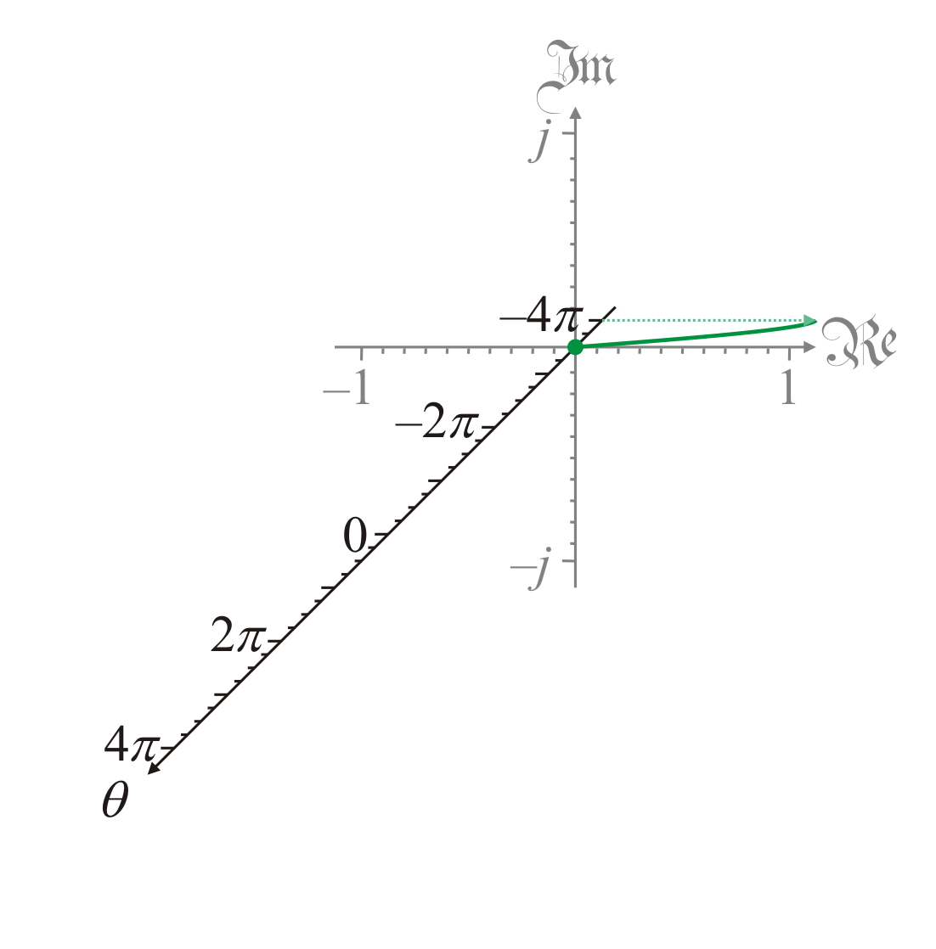
Geometric interpretation
Next, we note that
cos(–3.5π ) = 0

Slide 16
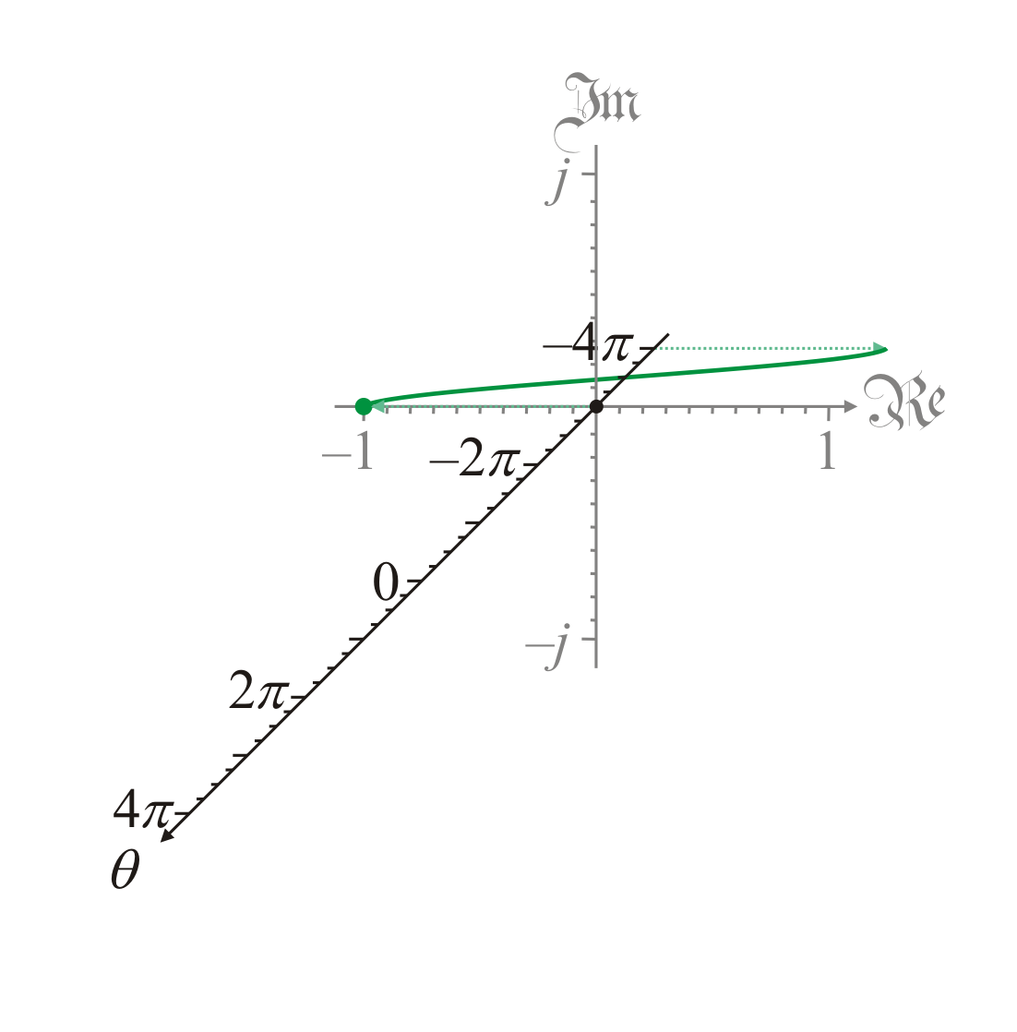
Geometric interpretation
Next, we note that
cos(–3π ) = –1

Slide 17
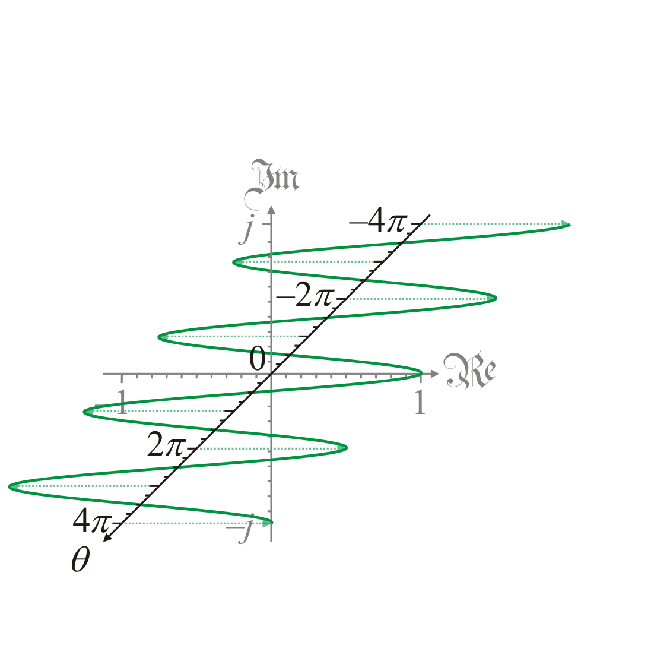
Geometric interpretation
Continuing this, we can
plot the cosine function
for all values in question
  The imaginary part
  is always zero
  All points lie in the
  xy-plane

Slide 18

Geometric interpretation
Next, lets plot e^{θ j}
  This is a complex-valued
  function of a real
  variable
  We note e^{–4πj} = 1

Slide 19
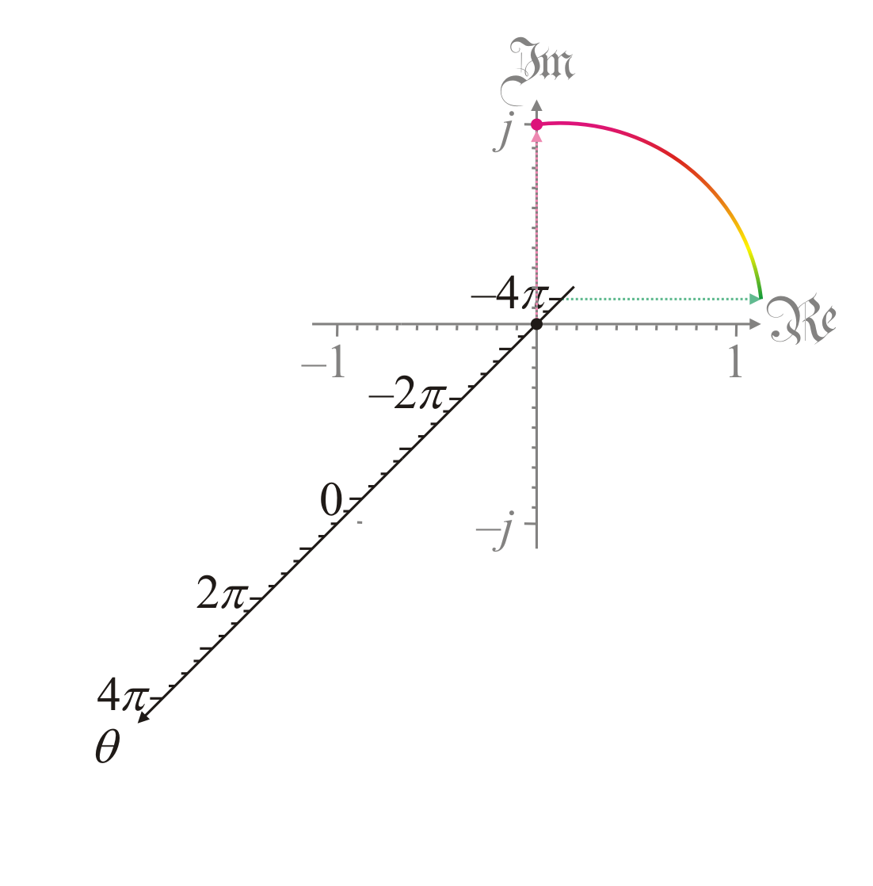
Geometric interpretation
Next, e^{–3.5πj} = j
  We use color to
  highlight the value of
  the imaginary
  component:
    Green is close to zero
    Magenta is the most
    positive
    Purple is the most
    negative

Slide 20
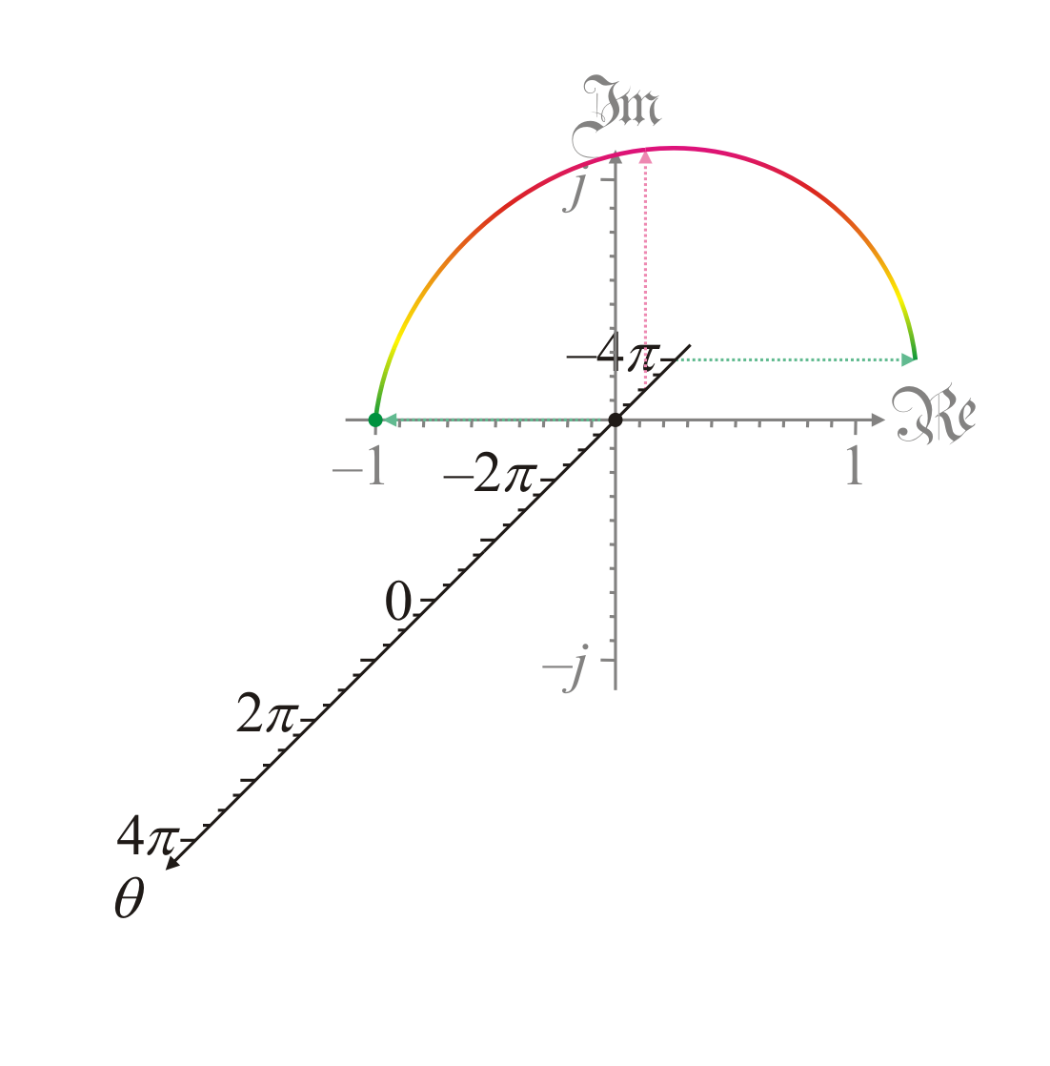
Geometric interpretation
Next, e^{–3πj} = –1

Slide 21
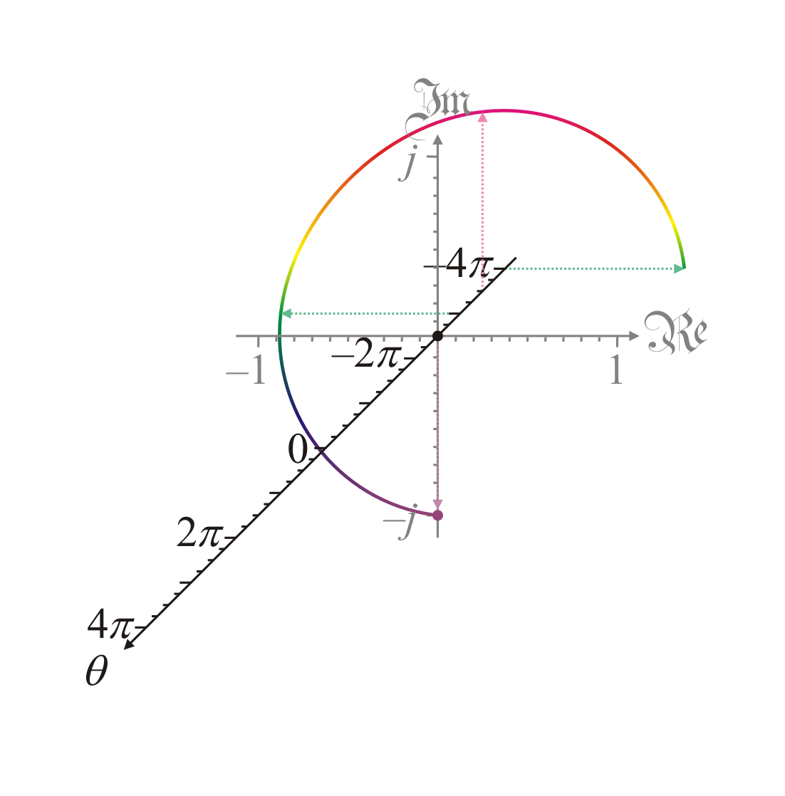
Geometric interpretation
Next, e^{–2.5πj} = –j

Slide 22
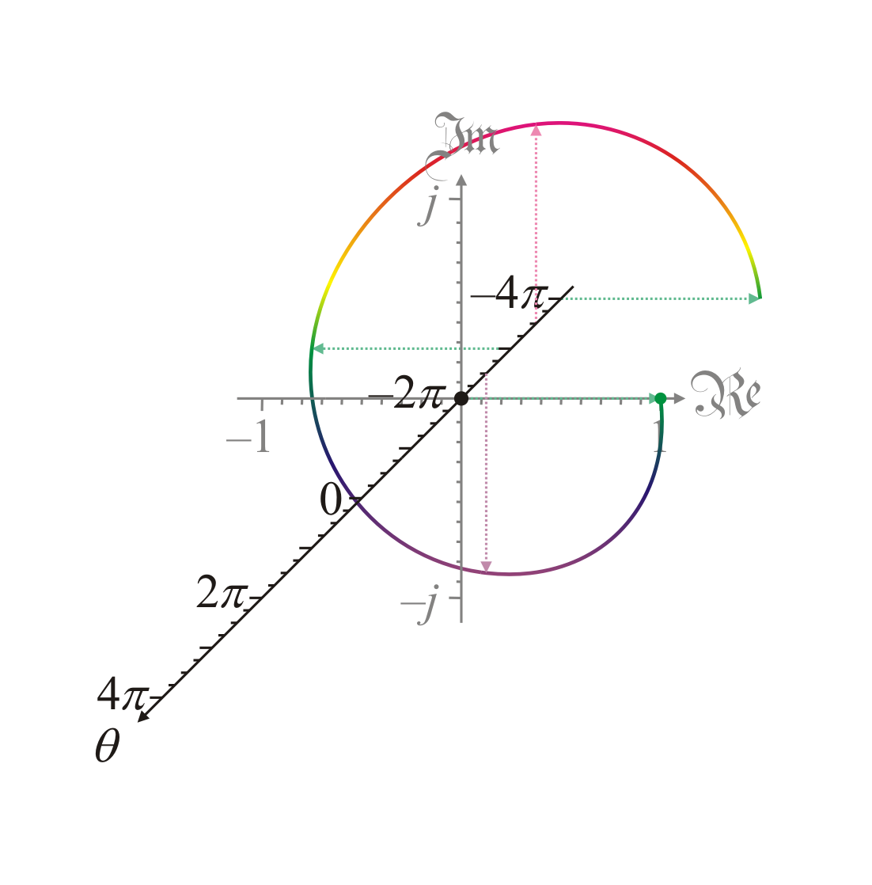
Geometric interpretation
Next, e^{–2πj} = 1
  Repeating this, we note
    e^{–1.5πj} = j
    e^{–πj} = –1
    e^{–0.5πj} = –j
    e^{–0πj} = 1

Slide 23
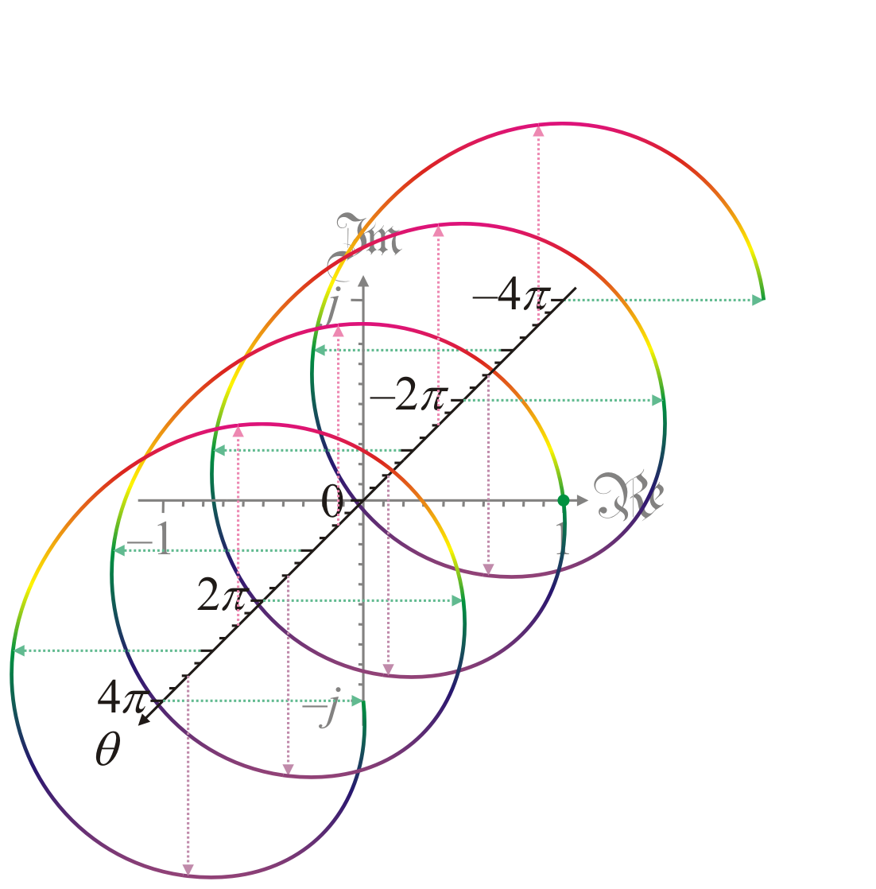
Geometric interpretation
Plotting e^{θ j} for more
values of q reveals a
corkscrew motion
  Recall that
  Here, we see that
  corkscrews through the
  complex plane for all θ

Slide 24
Complex exponential
Question?
  If z = α + βj, what is e^{z} ?
Solution:
  From secondary school, you know that
  Thus,

Slide 25
Complex exponential
As an example, let us try this out:
  For z = 0.09 – 0.3j, calculate and approximate e^{z} using the formula and the Taylor series:

Slide 26
Complex exponential
As an example, let us try this out:
  Using the 5th-order Taylor series approximation, we get that

Slide 27
Complex exponential
Let us compare our two results:
  Formula:
  Taylor series approximation

Slide 28
Observation
Theorem:
Proof: If , then
QED

Slide 29
Observation
Theorem:
Proof: A consequence of the previous theorem.

Slide 30
Euler’s identity
Theorem:
Proof:
QED

Slide 31
Trigonometric functions
What are cos(z) and sin(z)?
  We know for a real θ,
  Posit that continues to be true if z is a complex number
  Thus,
  Thus,
  Similarly,

Slide 32
Summary
In this topic, we described how to calculate the exponential function when the argument is complex
  We deduce Euler’s formula
    We saw that
  We determined formula for e^{z}
  We saw how to plot a complex-valued function of a real variable
    produces a spiral in the complex plane
  We checked the formulas are likely correct
  Made some observations, including Euler’s identity

Slide 33
References
[1] https://en.wikipedia.org/wiki/Euler%27s_formula
[2] https://en.wikipedia.org/wiki/Euler%27s_identity

Slide 34
Acknowledgments
Discussions with and courses from Prof. John A.R. Holbrook.

Slide 35



Colophon
These slides were prepared using the Cambria typeface. Mathematical equations use Times New Roman, and source code is presented using Consolas.
The photographs of flowers and a monarch butter appearing on the title slide and accenting the top of each other slide were taken at the Royal Botanical Gardens in October of 2017 by Douglas Wilhelm Harder. Please see
https://www.rbg.ca/
for more information.

Slide 36
Disclaimer
These slides are provided for the ne 112 Linear algebra for nanotechnology engineering course taught at the University of Waterloo. The material in it reflects the authors’ best judgment in light of the information available to them at the time of preparation. Any reliance on these course slides by any party for any other purpose are the responsibility of such parties. The authors accept no responsibility for damages, if any, suffered by any party as a result of decisions made or actions based on these course slides for any other purpose than that for which it was intended.

